Slide 1
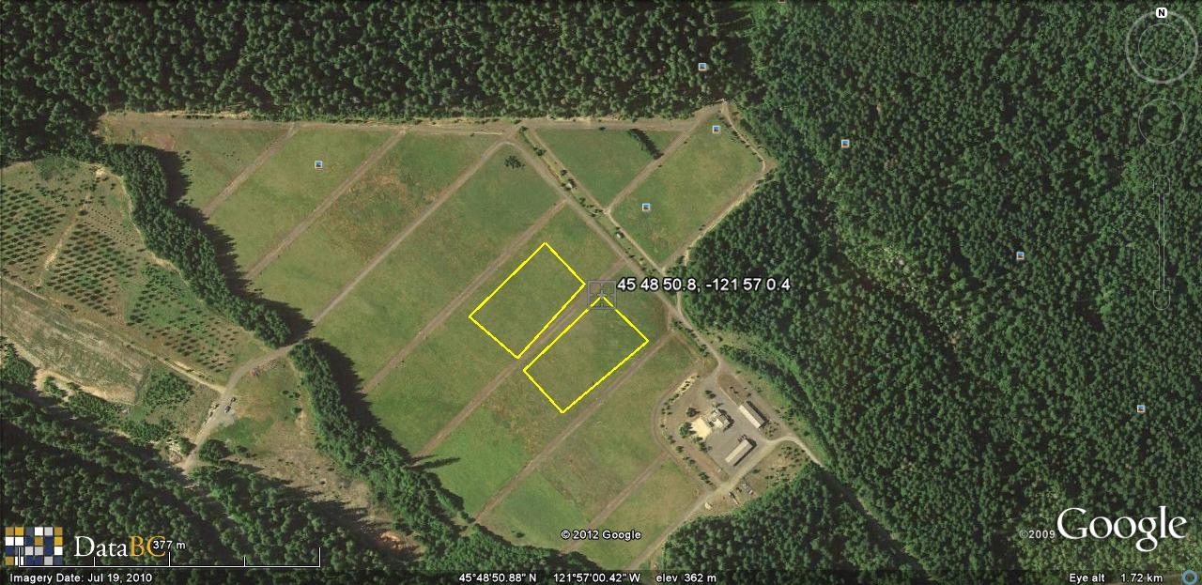
WIND RIVER AMAT PLANTED 2011
H
E
A
G
X Hobo weather Station
F
B
D
C
Wind River
Corner geographic coordinates
UTM Zone 10: 5815364 E,
5073849 N
Contact: Ken Bible
509-427-8019
Elev 360 m
A: 45°48’50.8” N
121°57’0.4” W
B: 45°48’48.9” N
121°56’57.9” W
C: 45°48’45.8” N
121°57’02.8” W
D: 45°48’47.6” N
121°57’05.1” W
E: 45°48’51.2” N
121°57’01.4” W
F: 45°48’48.1” N
121°57’06.1” W
G: 45°48’49.9” N
121°57’08.4” W
H: 45°48’53.0” N
121°57’03.8” W

